Slide 1
CoPilot
4imprint training

Slide 2
What is CoPilot
A program that easily allows our representatives and customers to navigate the 4imprint website together at the same time!

Slide 3
When would we use CoPilot?
Customer is on 4imprint site and:
needs assistance selecting a product for an event
having problems filter their searches
looking for USA made item
looking for blue writing ink
does not know how to search within a search
having a hard time describing what they are looking at on their screen
does not know how to place a reorder

Slide 4
Why would we use CoPilot?
To help customers quickly narrow down their search
To help customers become more comfortable and at ease with our site
To retain more customers by offering to do this for them
To help customers understand the functionality of our site

Slide 5
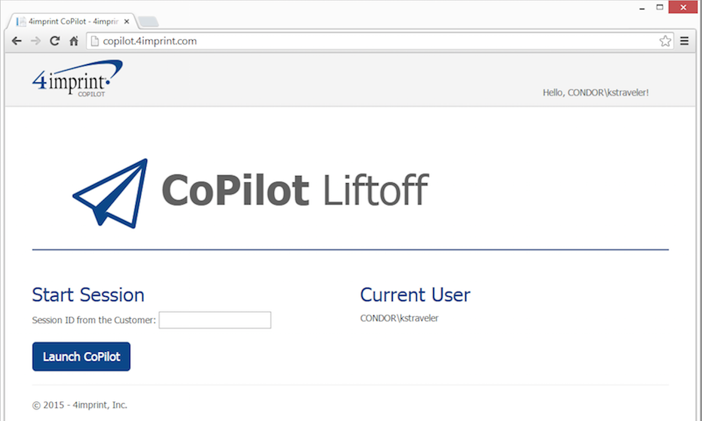
How does the representative access? Representative will access at copilot.4imprint.com (link is also on our intranet page to login in)

Slide 6
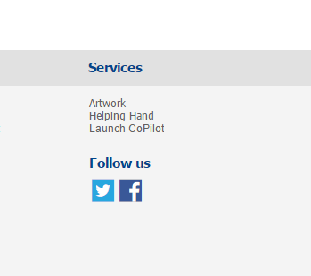
How does the customer access? Customers will click on the words Launch CoPilot at the bottom of our site under services.

Slide 7
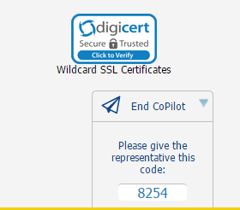
Customer will give rep 4 digit code

Slide 8
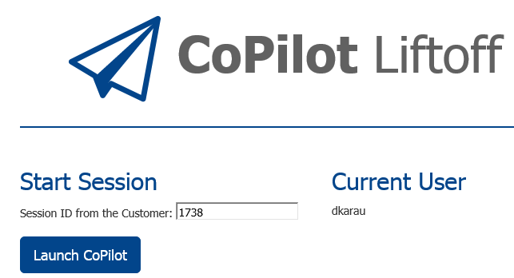
Representative enters Code & clicks on Launch CoPilot

Slide 9
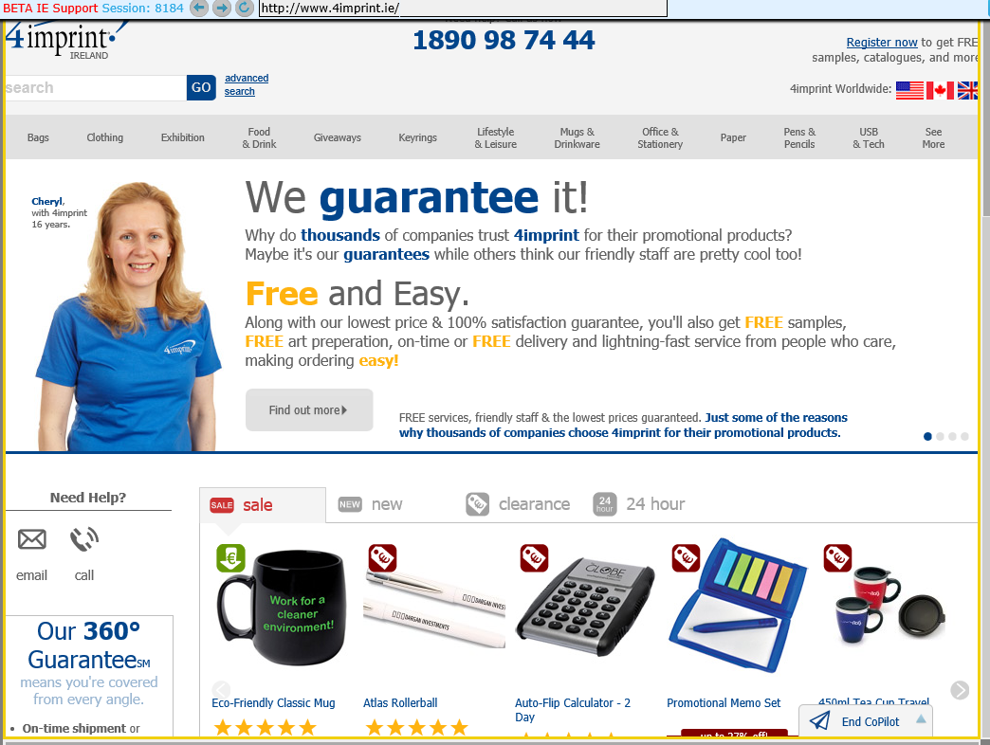
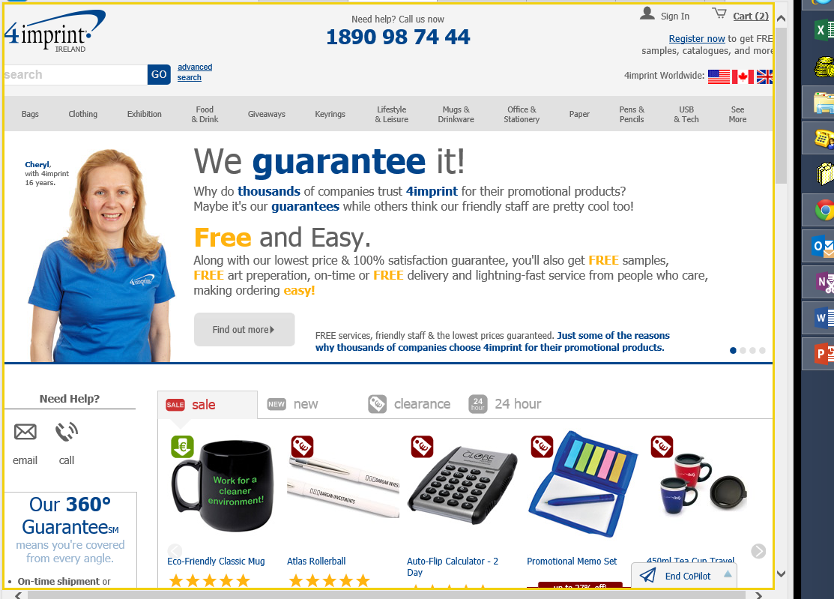
The representative will now see exactly what the customer is seeing on the 4imprint website.
Representative’s view
Customer’s view

Slide 10
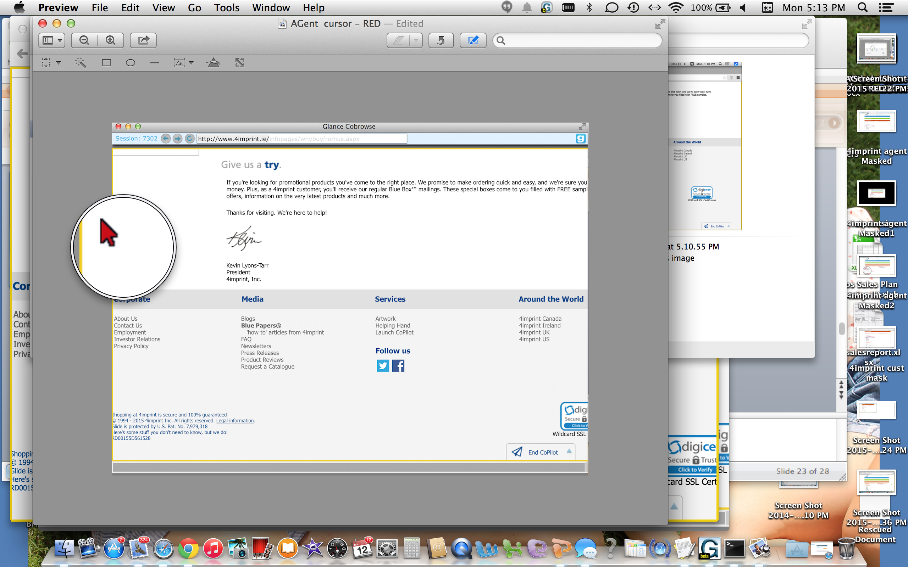
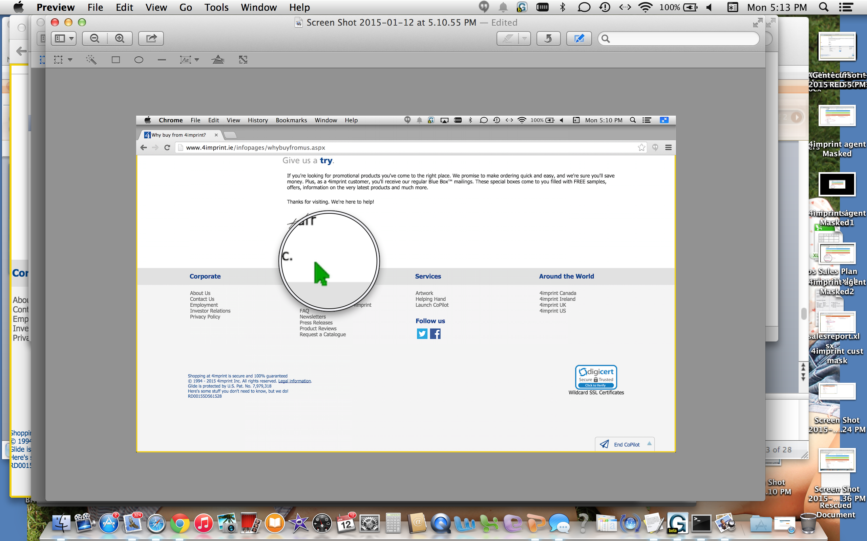
Representative can see customer’s mouse arrow and customer can see representative’s mouse arrow.
Representative: Red
Customer: Green

Slide 11
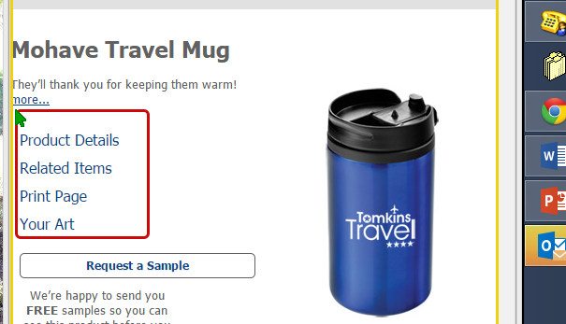
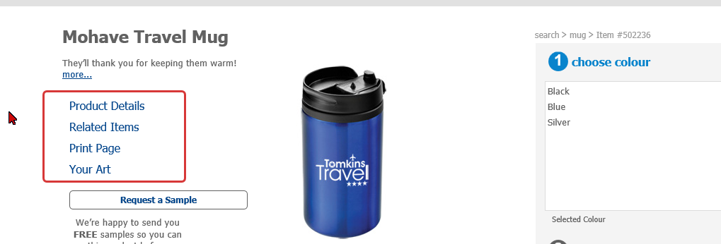
Representatives can click or draw boxes around items to highlight them for the customer.
Representative gesturing
Customer sees gesture

Slide 12
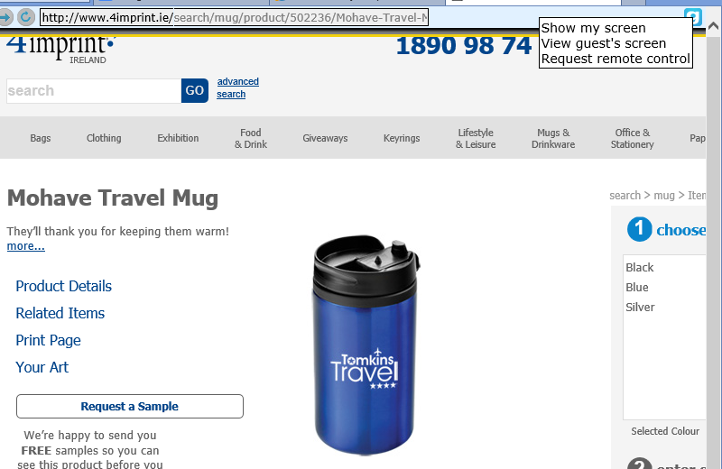
Representative is able to request remote control

Slide 13
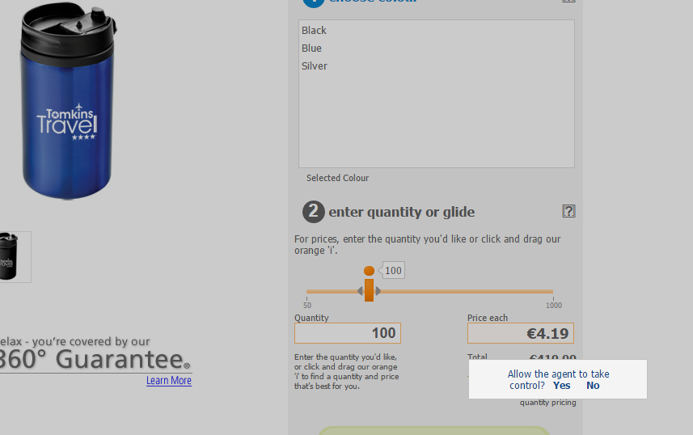
Customer’s view of “remote control” request

Slide 14
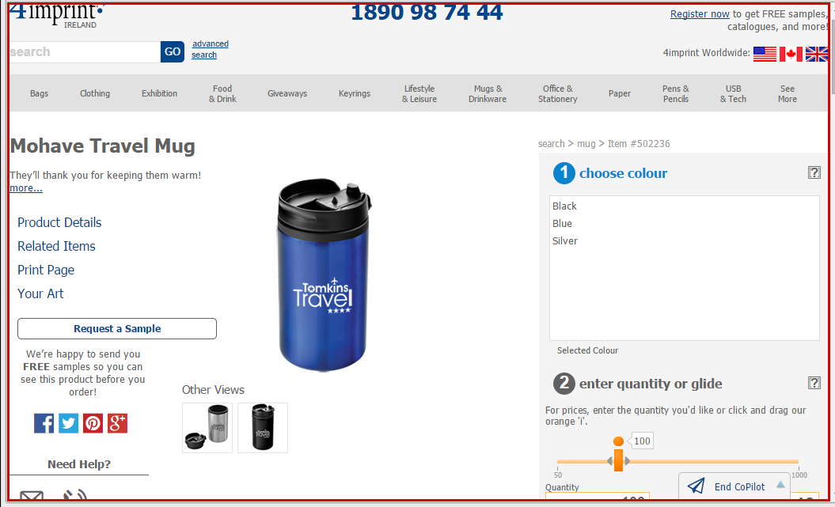
Representative’s view in Remote Control Request (red border). Representative can now ‘drive’ the session (clicking links, typing, etc.)

Slide 15
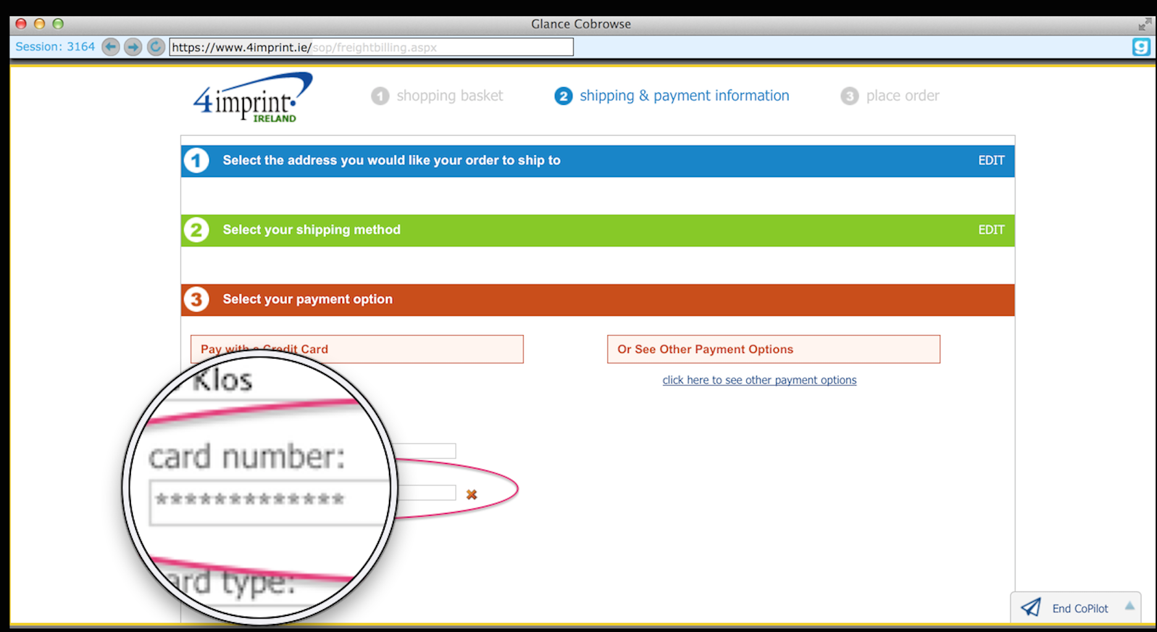
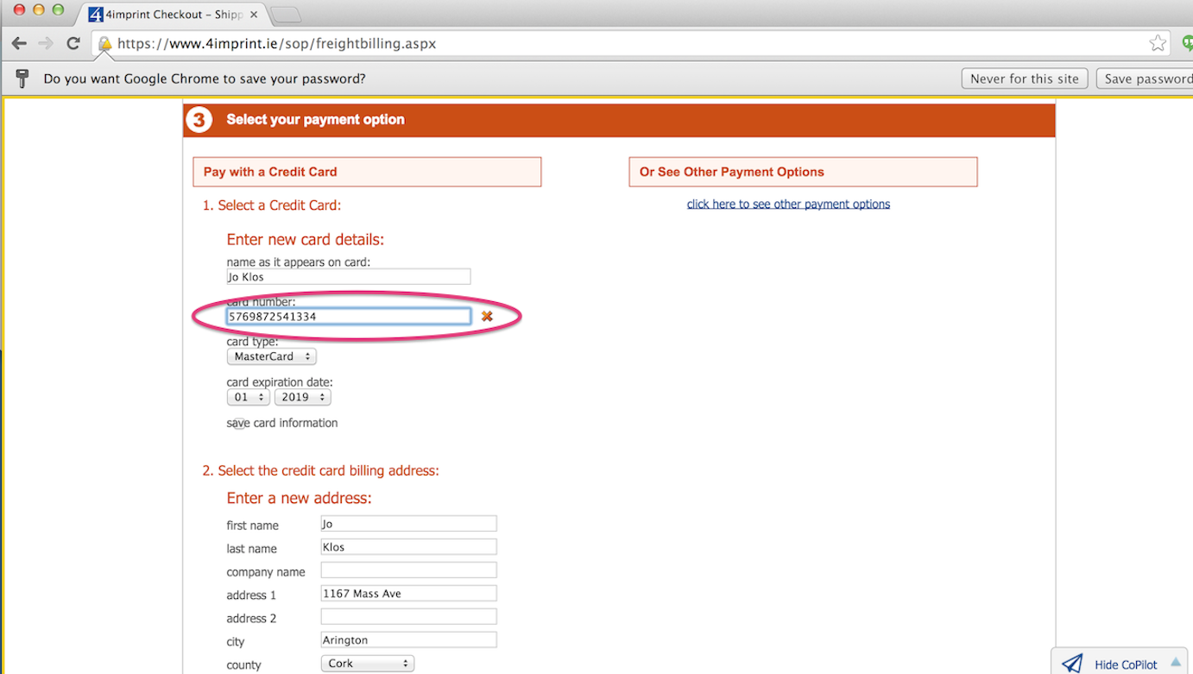
Sensitive data will be hidden from representatives.
Representative’s view – masked
Customer’s view - masked

Slide 16
How to end the Cobrowse session
Two options to end the Cobrowse session
1) Customer may end session by simply selecting the word “End CoPilot” in the bottom of their screen.
2) 4imprint representative may simply select the red “X” in their viewer window to close the session.

Slide 17
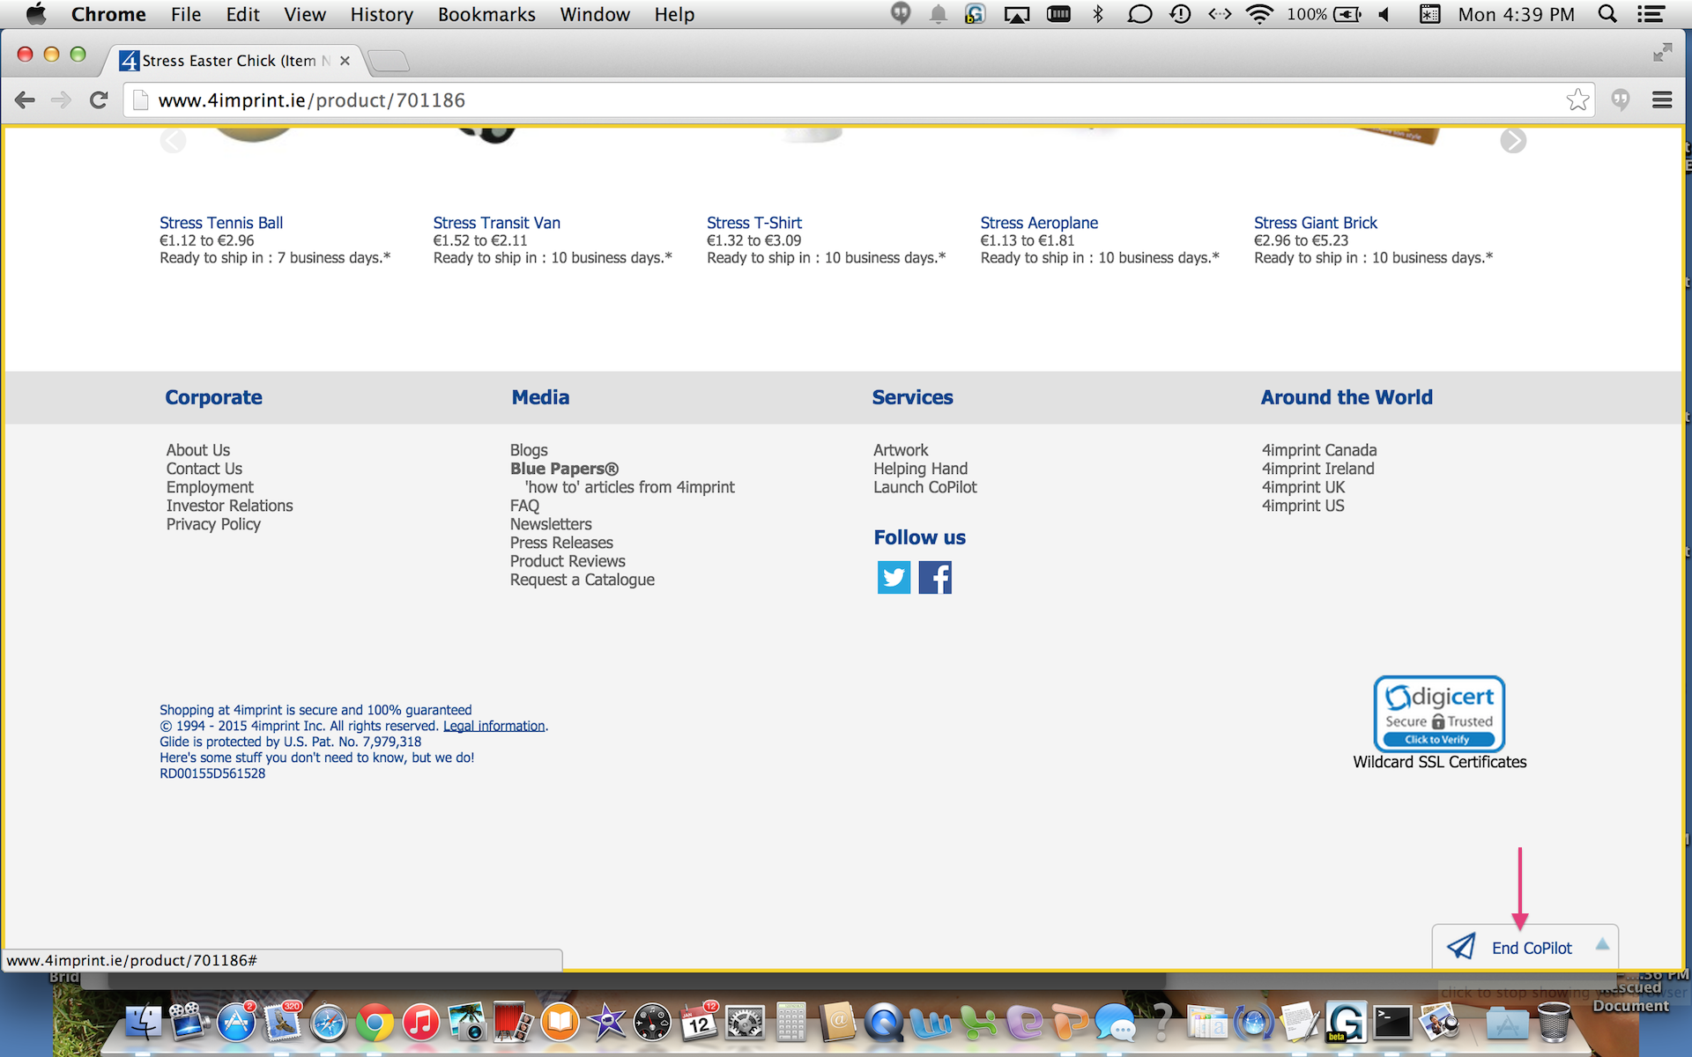
Customer end cobrowse session:

Slide 18
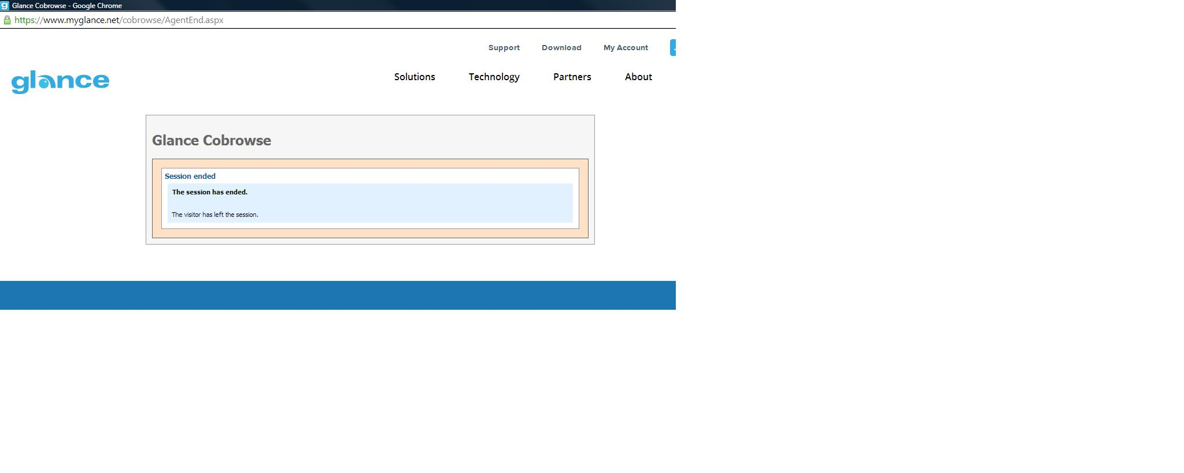
Representative’s view once cobrowse has ended

Slide 19
Definitions
Cobrowse: Representatives and customers are literally on the same 4imprint webpage. There is no customer download.
Gesture: Representatives may point to an area on customer’s page by clicking or dragging a box around an item.
Scroll: Representative may scroll up / down on the customer’s page.
Masked fields: When a customer is looking at personal account information, the field will not be viewable by the representative. Ex. CC information.
Remote Control: Ability to click on items and type in fields. Need customer’s permission.

Slide 20
FAQ
1. Where does the customer get the cobrowse Code?
A. Scroll down to Services and click on “Launch CoPilot.”
2. How do I join the cobrowse session?
A. Join via copilot.4imprint.com and enter the cobrowse code from the customer.
3. Can I gesture / highlight on the customer’s screen?
A. Yes, you are able to draw boxes around an area or click on an item to highlight. You may also scroll up / down the page for the customer.

Slide 21
FAQ
4. Why can’t I control the customer’s screen?
A. You will need to request access this permission from the customer. Click on the “g” icon in the top right hand corner and select “Request Remote Control”. Once granted you will be able to scroll, click on items and type.
5. Customer is concerned about security
A. Customer is not downloading software on their computer. You may see the 4imprint webpage they are on but have no access to view their desktop and files or other web pages.
6. How do I end the cobrowse session?
A. Customer may select “End CoPilot” or you may simply exit the browser.

Slide 22
Browsers that can be used
4imprint Agent
4imprint Customer
IE 11
Chrome
Safari
Visitor / Client
Which Browser? | On what Operating System?
IE9+ | Windows
Firefox 30+ | Windows, Mac
Safari 5+ | Mac, iOS
Chrome | Windows, Mac, Android

Slide 23
Logins
Representative:
copilot.4imprint.com
Customer:
www.4imprint.ie

Slide 24
Thank you!

